Slide 1
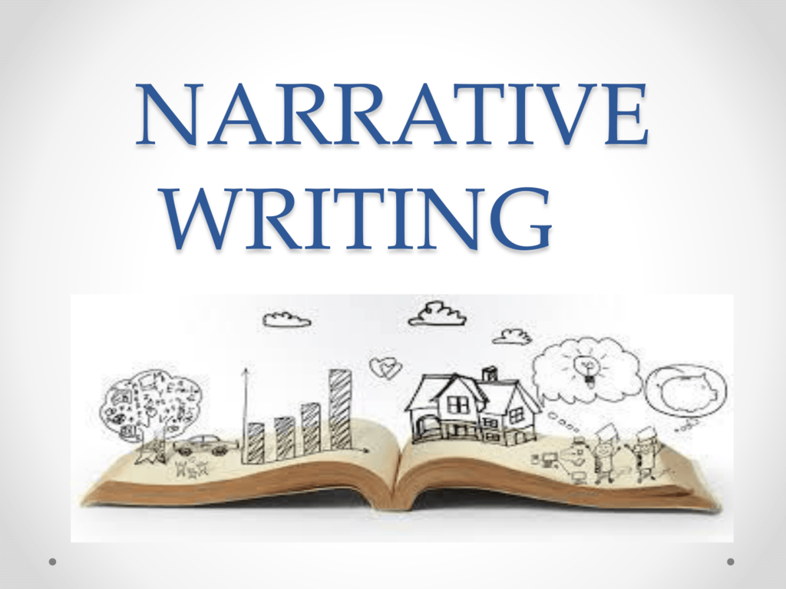

Slide 2

WHAT ARE THE TYPES OF CONFLICTS
AND HOW ARE THEY
USED WHEN WRITING
A STORY

Slide 3
WHAT IS A CONFLICT?
Before we can lecture you on the different types of conflicts you must first know what a conflict is.
In Narrative Writing the conflict is the problem that needs to be overcome by the main characters in the story so you can draw your readers attention even deeper.

Slide 4
Conflict (cOn.)
The conflict is a major literary element of a narrative story, without it their would be point for the reader to read it.

Slide 5
TYPES OF CONFLICTS
The different types of conflicts are:
Person versus Self
Person versus Person
Person versus Society
Person versus Technology
Person versus Nature
Person vs Super-natural

Slide 6
PERSON VS SELF
Person versus self is where the character is their own enemy. This type of conflict can make your story even more suspenseful when the character is dealing with self conflict.
Example:
It was Friday and David was looking forward to the weekend but then Miss McKenzie announced that one of his classmates has lost a thousand dollars, it is her bus fair to go home. The class gratefully made up for her loss, when David got up from his seat he saw the one thousand dollars, he knew he should give it to his classmate but he took it for himself even though he felt guilty for it.

Slide 7
PERSON VS PERSON
Person versus Person is a conflict between two characters who have opposing desires and interest. It can be said that this is a conflict between the protagonist and the antagonist.
NB: (the protagonist is the character who works towards the central goal of the story. While the antagonist is the character who works against it)
Example: David and Jenna argued all week about who will be taking their school to the “All Together Sing Finals”

Slide 8
PERSON VS SOCIETY
The Person versus Society conflict is when a protagonist has a strong belief against the majority of the community or surroundings and decides to act on it.
NB: (Since this type of conflict is between a character and an outside group, it is classified as an external conflict)
Example: After he left the school David walked home, but before he could reach his house a group of protesting black lives don't matter, the group of people looked at David but he didn't hesitate to return the look.

Slide 9
PERSON VS TECHNNOLOGY
A Person versus Technology Conflict is when the protagonist is facing machines or technology and must prevail against it.
Example: When he got to his house David started off the weekend with a movie, he took out his laptop and turned it on, but it didn’t come on. David spent 30 minutes trying to turn on his laptop.

Slide 10
PERSON VS NATURE
A Person versus Nature conflict happens when nature itself is against the protagonist. It can be an earthquake taking place where the character lives or simply by the rain coming down on the character at the wrong moment.
Example: David decided to spend his Saturday afternoon with his friends but the rain ended up catching him on the road. When he got home he was soaking wet.

Slide 11
PERSON VS SUPERNATURAL
A Person versus Supernatural conflict is a conflict between the protagonist and a force or character that is not considered normal.
Example: It was Sunday and David was not looking forward to going back to school on Monday, he went outside to get some fresh air, but when he looked up he saw something fly across the blue sky, it was too fast to be an airplane, and it was nothing shaped like one, it was triangular shaped, David immediately ran back inside.

Slide 12
SUMMARY
A conflict is a problem or situation that must be resolved by the main character
The different conflicts are:
Person versus Self- When the character Is against himself.
Person versus Person- When the character Is against another character.
Person versus Society- When the character Is against a larger group of people.
Person versus Technology- When the character Is against Technology.
Person versus Nature- When the character Is against nature its self.
Person vs Supernatural- When the character Is against the abnormal.

Slide 13


